Slide 1
Udemy Courses’ Analytics
Pravah Malunjkar

Slide 2
AGENDA
Introduction​
Dataset Overview
Sample Data
​Distribution Metrics​
Average Based Metrics for Empirical Analysis
Correlation Analysis

Slide 3
Introduction
Udemy Courses are a great source of college equivalent courses for any user with curiosity, internet and willingness to pay. But it can be very difficult to understand the way Udemy and its courses work. Courses are defined in various levels as well as durations. And characteristics like these can determine the value of a course.

Slide 4
Dataset Overview
The data related to each course is as such:
course_title: The title of the course. (String)
url: The URL of the course. (String)
price: The price of the course. (Float)
num_subscribers: The number of subscribers for the course. (Float)
num_reviews: The number of reviews for the course. (Float)
num_lectures: The number of lectures for the course. (Float)
level: The level of the course. (String)

Slide 5
Required tools
For analysis of the given dataset we are using Python and its relevant packages such as Numpy, Pandas, Matplotlib and Seaborn. To import these packages we write:
import numpy as np
import pandas as pd
import seaborn as sns
import matplotlib as mpl
import matplotlib.pyplot as plt

Slide 6
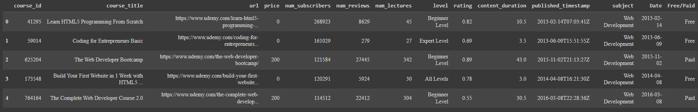
Sample data
Using the .head() function we can display the first 5 data rows of the dataset.

Slide 7
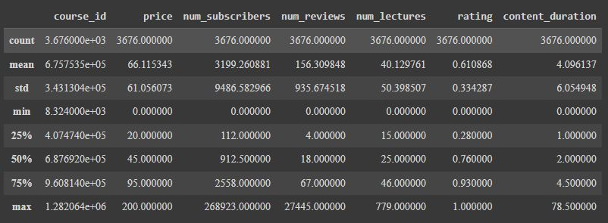
Simple Metrics
Using .describe() we can have basic statistical metrics for all the interval data columns.

Slide 8
Courses rating Metrics
There are total 1030 courses with a rating score of 0.9 and above.
Business Finance : 370
Web Development : 334
Graphic Design : 282
Musical Instruments : 44
Whereas there are only 11 courses with the rating of 1.
Web Development : 6
Musical Instruments : 4
Business Finance : 1

Slide 9
Courses Subscription Metrics
The course with the highest subscriber count is ‘Learn HTML5 Programming From Scratch’.
The course with the lowest subscriber count is ‘ABRSM Grade III Piano Class - Handel Sonatina in G 2017-2018’.

Slide 10
Distribution Metrics

Slide 11
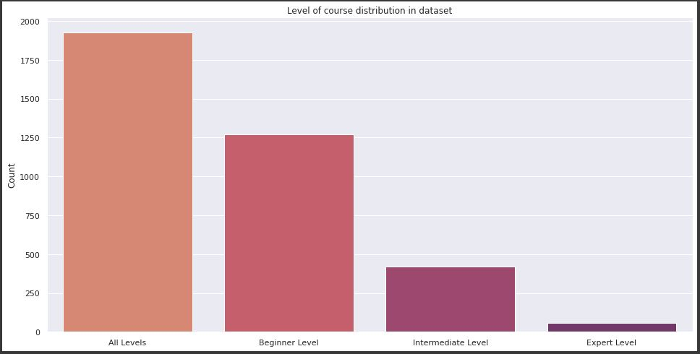
Course level distribution
It seems that Udemy is designed with novices in mind. This encourages users to advance to the next level if they like the beginner level course.

Slide 12
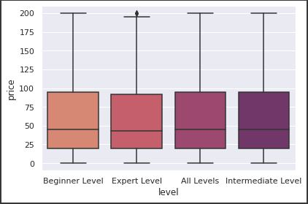
Course level vs. Price distribution
Although there are some outliers in the Expert Level the rest of the course prices seem to be skewed below or at $100 dollars with the mean somewhere around $50. This increases the affordability and user count considering the abundance of beginner level courses.

Slide 13
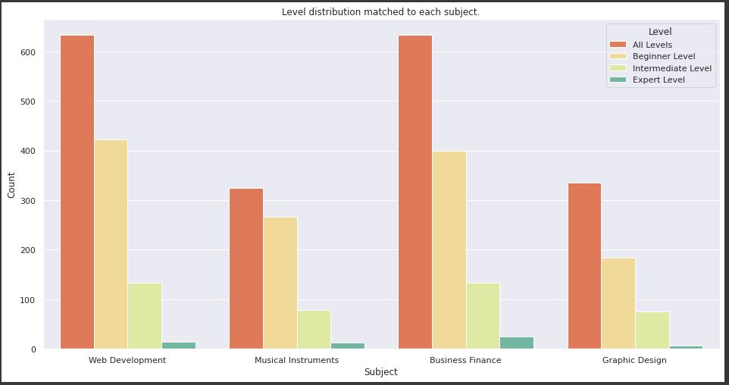
Course level distribution Per Subject
The number of expert level courses hardly make up for 10% of beginner level courses. This suggests that Udemy knows that its users prefer entry level skills predominantly. But it lacks ‘All Levels’ courses for Musical Instruments and Graphic Design which suggests users do not want to pay for all levels.

Slide 14
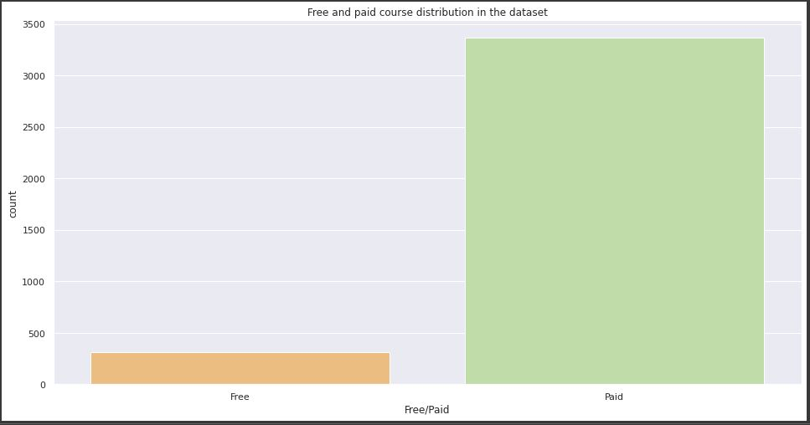
Course Distribution: Free vs. paid
From previous metrics we can see that by promoting beginner level courses with affordability in mind Udemy earns revenue from wide range of courses.

Slide 15
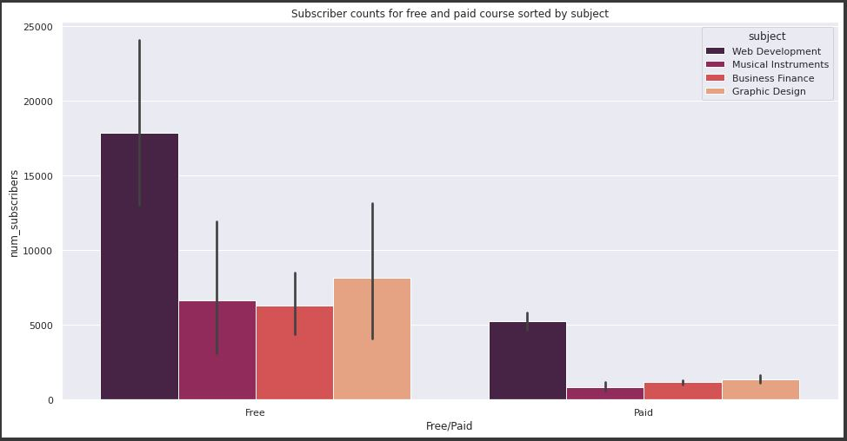
Subscriptions based on free/paid, sorted by subject
New users of Udemy prefer to explore free courses over paid ones. And the current trend seems to be Web Development.

Slide 16
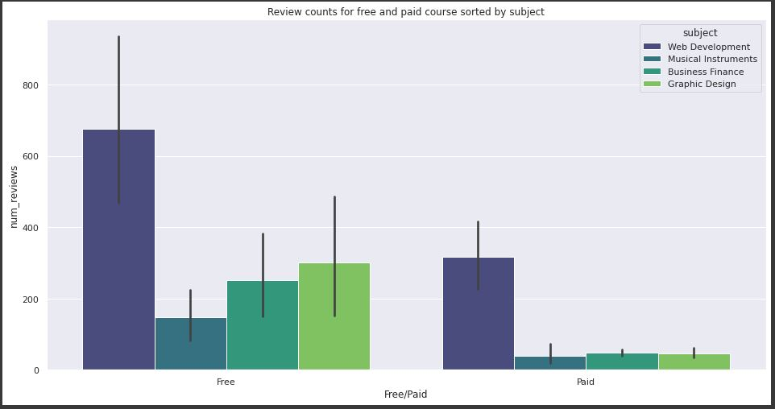
Reviews based on free/paid, sorted by subject
Similarly these new users of Udemy reviewed free courses more often than paid ones. This also depicts the feedback frequency of users for free courses.

Slide 17
Conclusions
With a few really expensive courses and others in between, the majority of courses cost between $25 and $50.
There are typically between 0 and 25000 subscribers every course.
There were roughly 1000 reviews total, and after that, very few courses received noteworthy feedback.
Rarely do lectures for a course reach 100.
There is a noticeable bias towards 1.0 in the rating property.
Many courses offer content that lasts less than 10 minutes.
Out of all the subjects, music classes are the least expensive and are generally rated the lowest.
Out of all the subjects, a web development course provides the most lectures and substance to the students. Additionally, it is by far the most well-liked topic in this dataset.

Slide 18
Average based metrics for empirical analysis

Slide 19
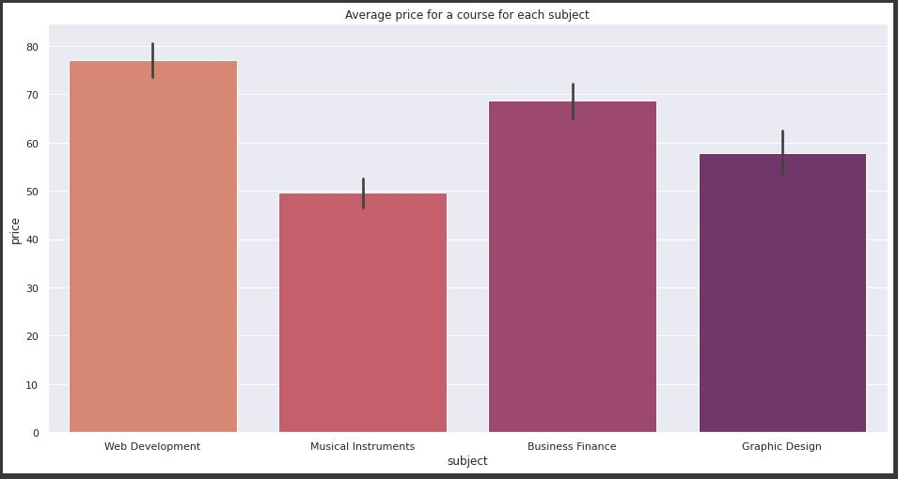
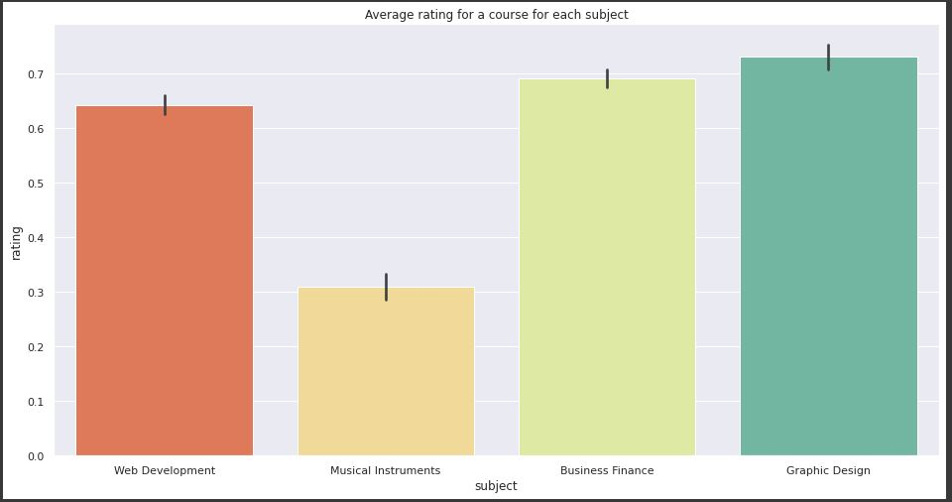
Average Price and rating per Subject

Slide 20
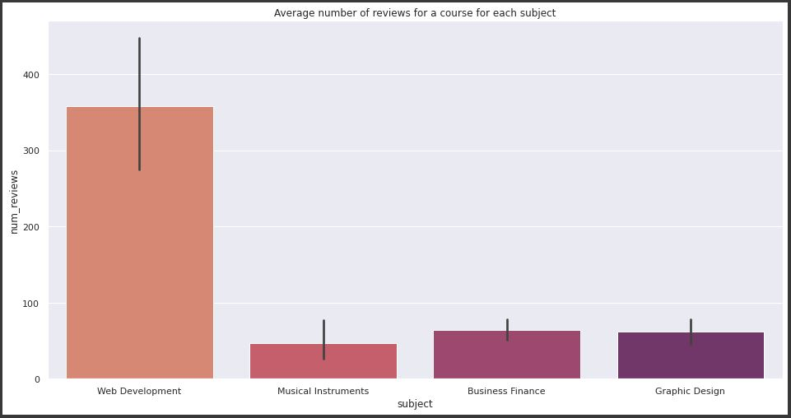
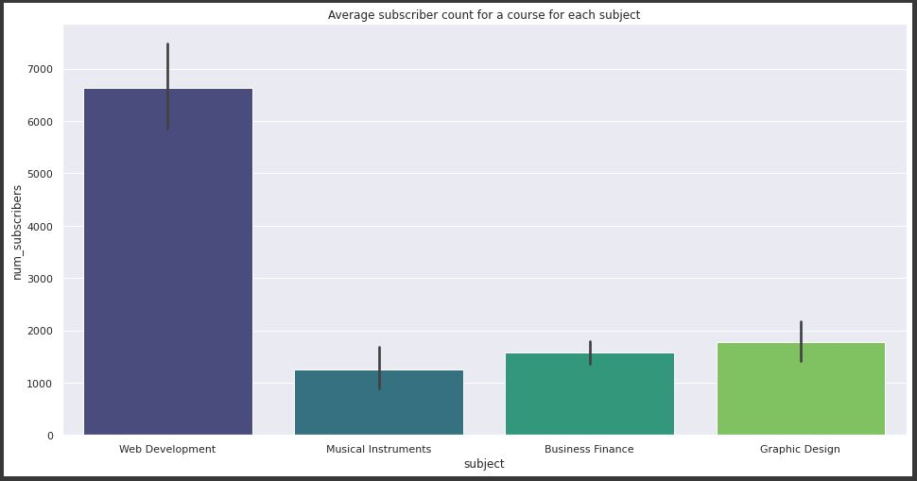
Average Reviews and Subscriptions per Subject

Slide 21
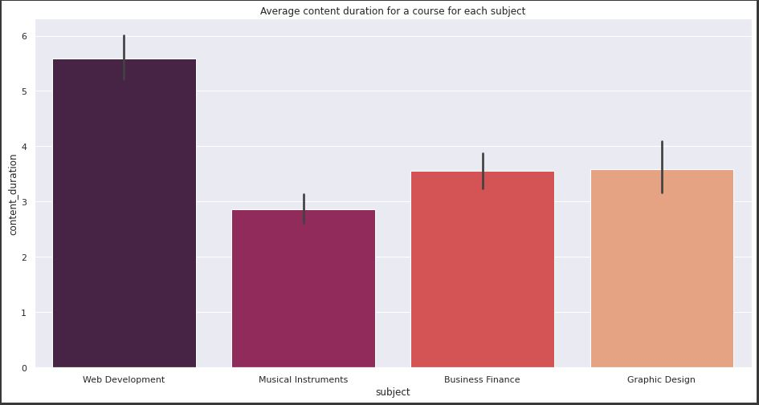
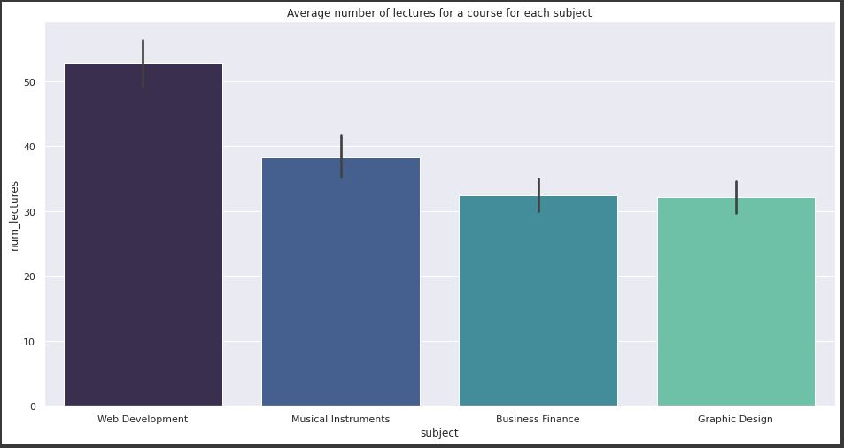
Average Content Duration and Lectures per Subject

Slide 22
Correlation Analysis

Slide 23
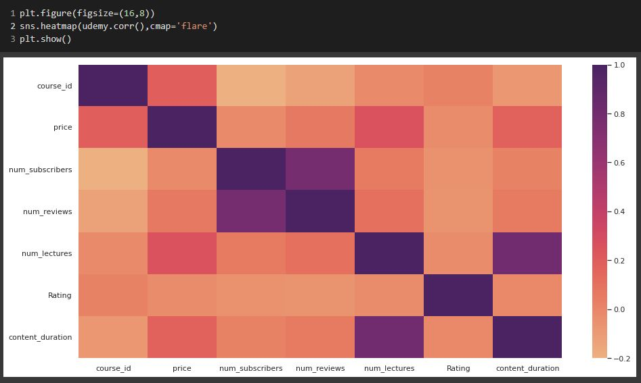
Basic Correlation Heatmap

Slide 24
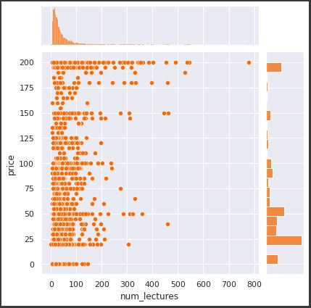
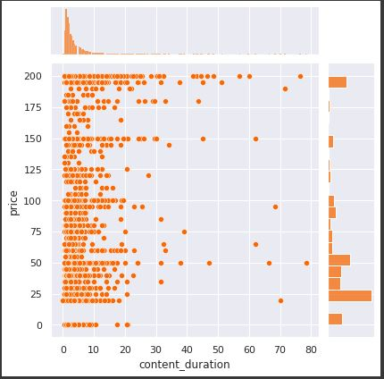
Correlation Based on Price and Lecture Characteristics
Between the number of lectures and the content duration, the number of lectures proves to have a marginally better correlation with the price of the course. Thus users are paying for more quantity over volume.

Slide 25
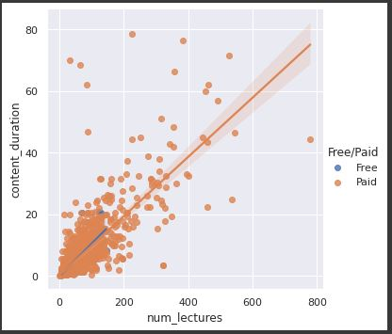
Correlation between No. of Lectures and Content Duration.
There is a strong correlation between the number of lectures and the content duration such that it represents a linear regression between the two variables.

Slide 26
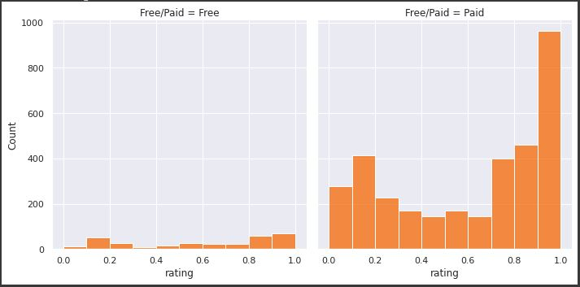
Ratings based on Free/Paid
Users only tend to leave ratings on courses they have paid for because the number of ratings for free courses is drastically low. This might also be because Udemy promotes feedback for paid courses over free courses.

Slide 27
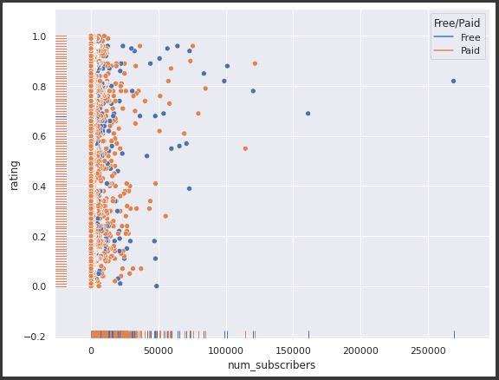
Correlation between ratings and subscriptions
No proper correlation can be claimed without a regression plot. The only conclusion found here is that the most subscribed course has the rating of 0.82 and it’s a free course.

Slide 28
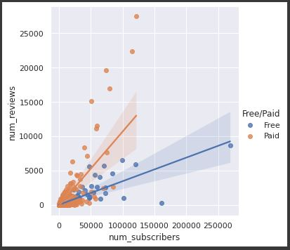
Correlation between Reviews and subscriptions
There is an evident regression model here suggesting that the subscription count is directly proportional to the number of reviews. But this proportionality is different for free and paid courses.

Slide 29
THANK YOU!

